Slide 1

COVID RESPONSE POLICY AMONG COUNTRIES WITH DIFFERENT HAPPINESS LEVELS
Sheng CAO
Xiaolin ZHENG
Tianjiao GAO
Xiangting YE

Slide 2
Brief Summary
Methods
EDA
Machine Learning
Cluster
Improvement
Research Question
Covid Response Policy among Countries with Different Happiness levels

Slide 3
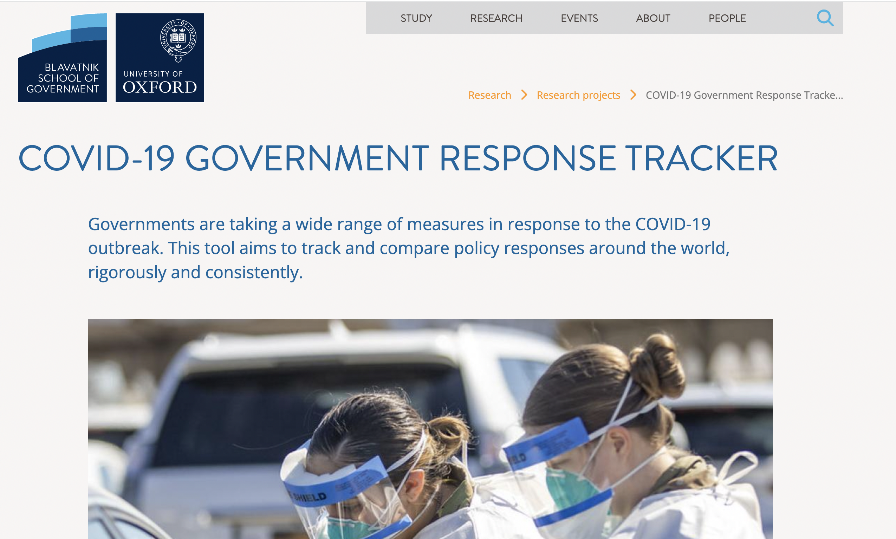
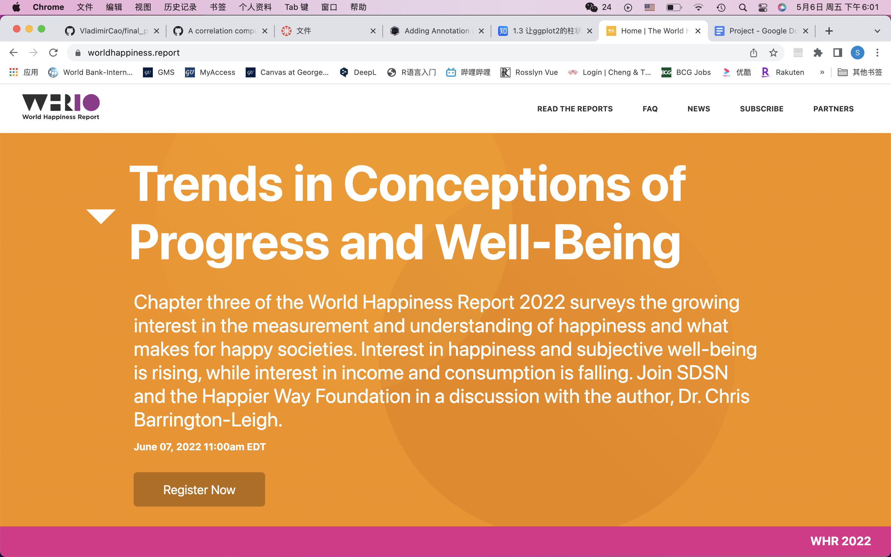
Brief Summary
Methods
EDA
Machine Learning
Cluster
Improvement
Data source
Oxford Covid-19 Government Response Tracker
World Happiness Report

Slide 4
Brief Summary
Methods
EDA
Machine Learning
Cluster
Improvement
Data source
Oxford Covid-19 Government Response Tracker
World Happiness Report
Government response index: represents the strength of country’s closure, economic support and health investment policy
Containment and health index: represents the strength of country’s closure and health investment policy
Stringency index: represents the stringency of country’s closure policy
Economic support index: represents the strength of country’s economic support policy
Happiness index
Log GDP per capita
Social support Index
Healthy life expectancy by years
Freedom Index
(freedom to make life choice)
Generosity
Perception of corruption

Slide 5
Brief Summary
Methods
EDA
Machine Learning
Cluster
Improvement
Methods
Machine Learning
Geospatial Analysis
Cluster Analysis
Lasso + Random Tree

Slide 6
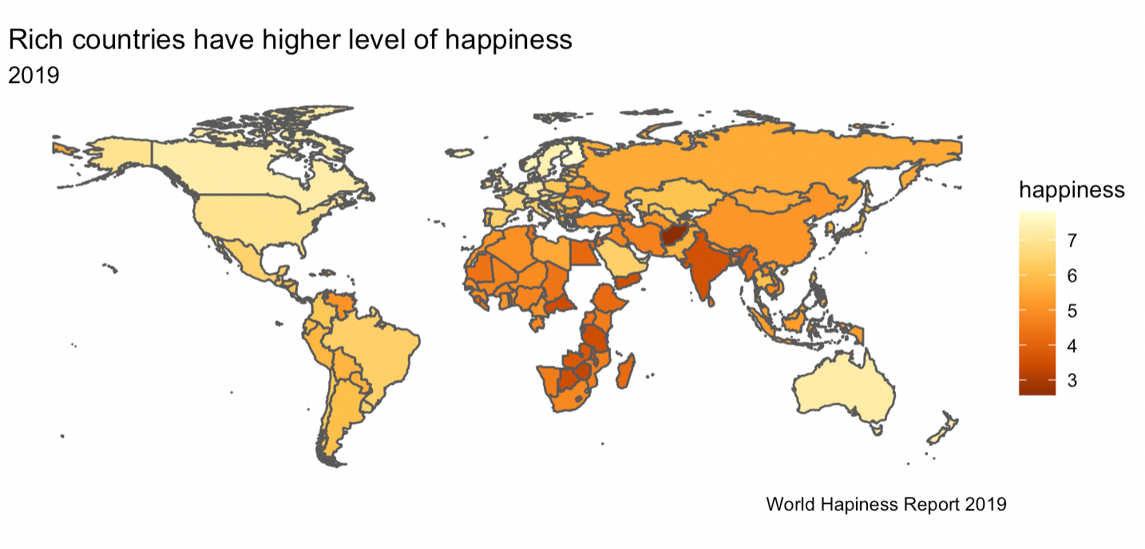
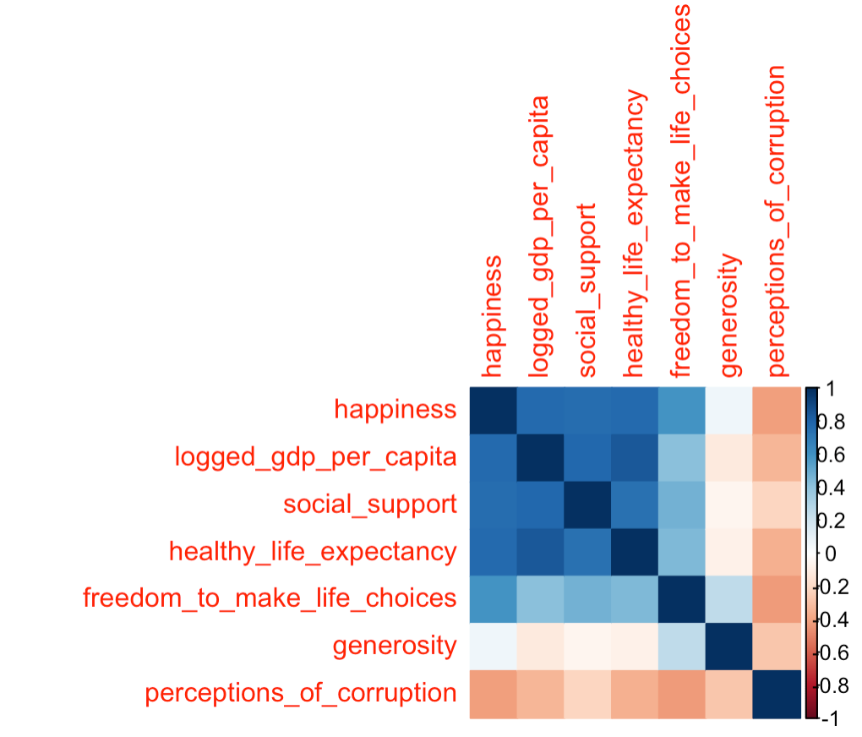
Brief Summary
Methods
EDA
Machine Learning
Cluster
Improvement
Exploratory Data Analysis
Notes:
Rich countries have higher levels of happiness:
To begin with, we only used World Happiness Report 2019 from the first dataset to draw a world map with the degree of happiness in 2009. In the map, dark orange stands for lower level of happiness, and vice versa. It is clear that North America, Western Europe and Australia where wealthy countries concentrate are endowed with much higher levels of happiness than those parts of the world with middle-income and low-income countries.
The heatmap:
The heatmap represents the correlation between seven variables. They are happiness, logged gdp per capita, social support, healthy life expectancy, freedom to make life choices, generosity and perceptions of corruption respectively. Dark blue is the sign of strong positive correlation and dark red means strong negative correlation. Happiness, logged gdp per capita, social support and healthy life expectancy have rather strong correlations with each other, for their covariances are all higher than 0.4. Perceptions of corruption are negatively correlated with other six variables and the covariances are located between -0.2 and -0.4.

Slide 7
Brief Summary
Methods
EDA
Machine Learning
Cluster
Improvement
Machine Learning
Lasso
RMSE: 0.5864738
Fit Resamples in the training set
Random Tree
Fit the test set
Predict
To choose the best model between Lasso and Random Tree
To choose the best parameters
Random Tree
RMSE: 0.5234866
Data:
World Happiness
Report 2019
Data: World Happiness Report 2020
Notes:
First of all, we split the World Hapiness Report 2019 data into training set and the validation set. Then we use lasso and random tree to fit resamples in the training set to choose the best parameters for those two models. Then we select the best parameter based on the average RMSE across the resamples. Then we use the best parameter to fit the validation set to choose between the lasso and random tree model. As we can see, the RMSE for Lasso is 0.586, and RMSE for random tree is 0.523. Therefore, we choose Random Tree to predict the happiness score for 2020.

Slide 8
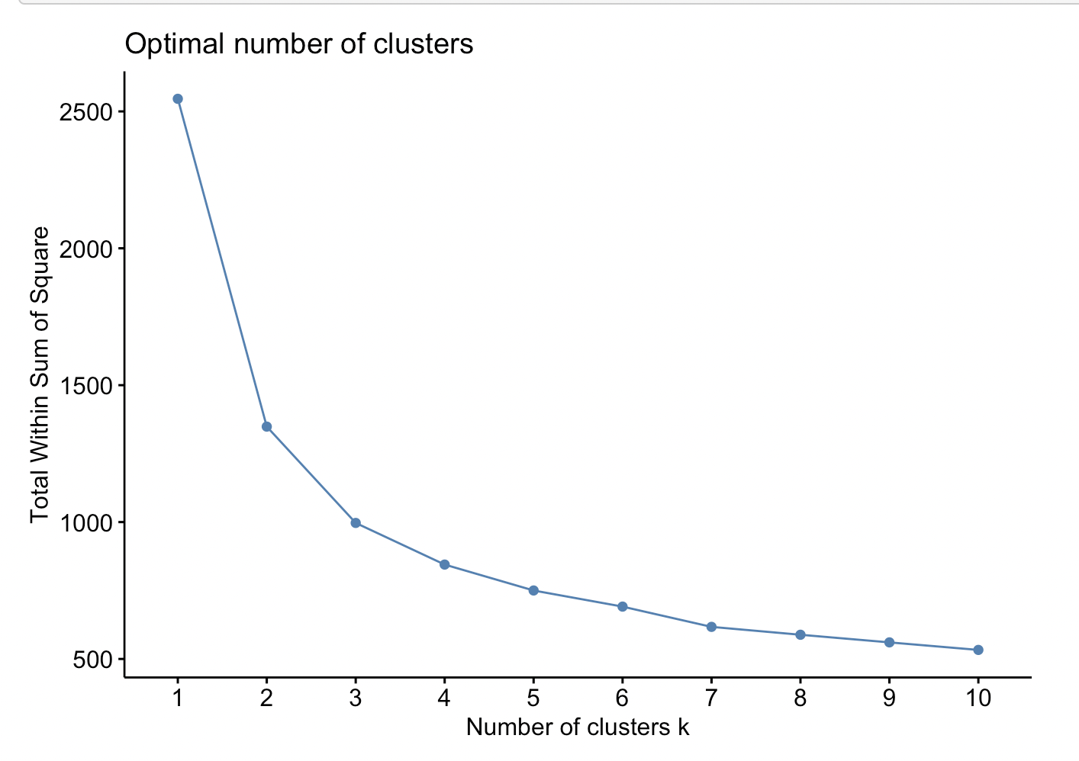
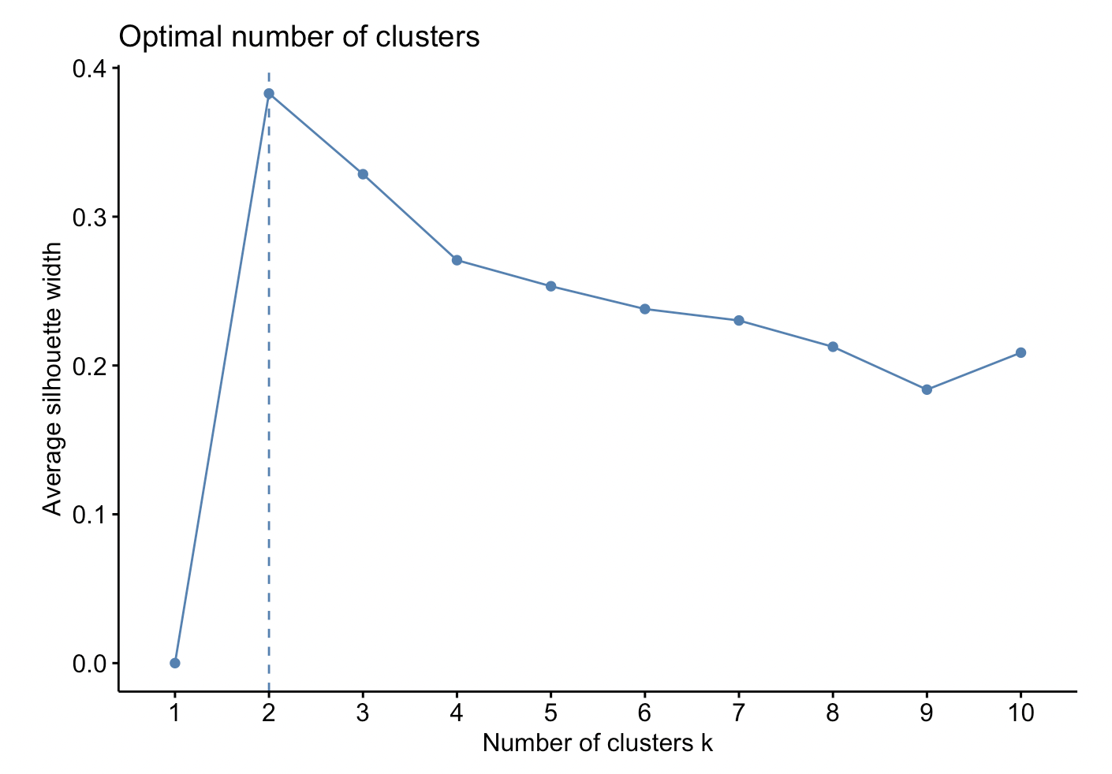
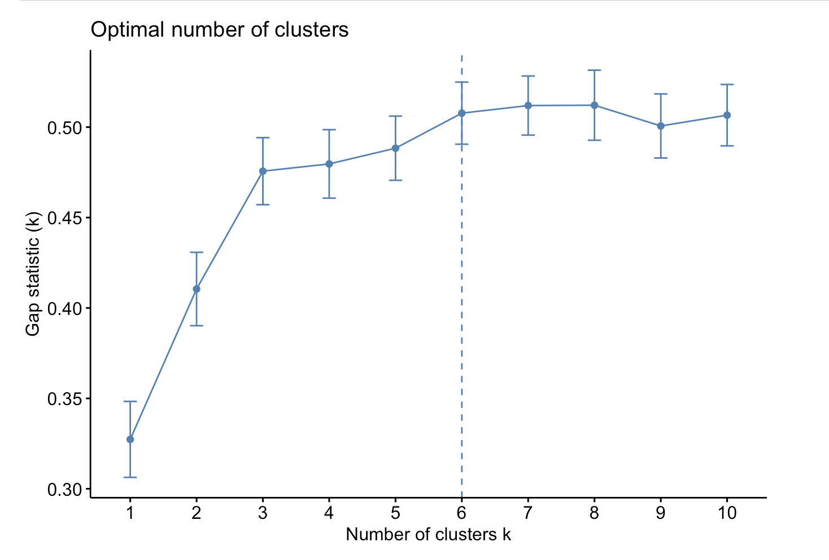
Brief Summary
Methods
EDA
Machine Learning
Cluster
Improvement
Cluster Analysis
WSS
Silhouette
Gap statistics
We choose to divide countries into 3 groups

Slide 9
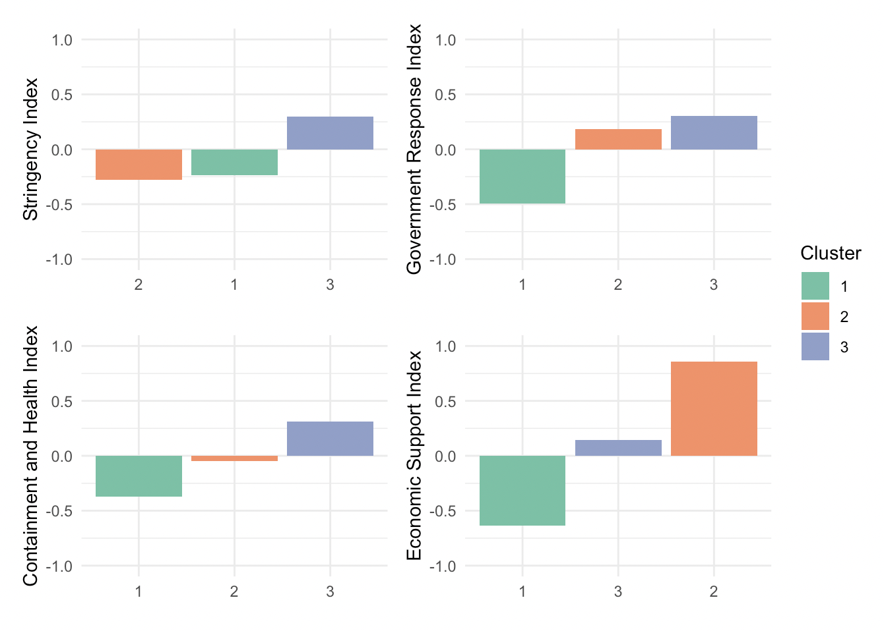
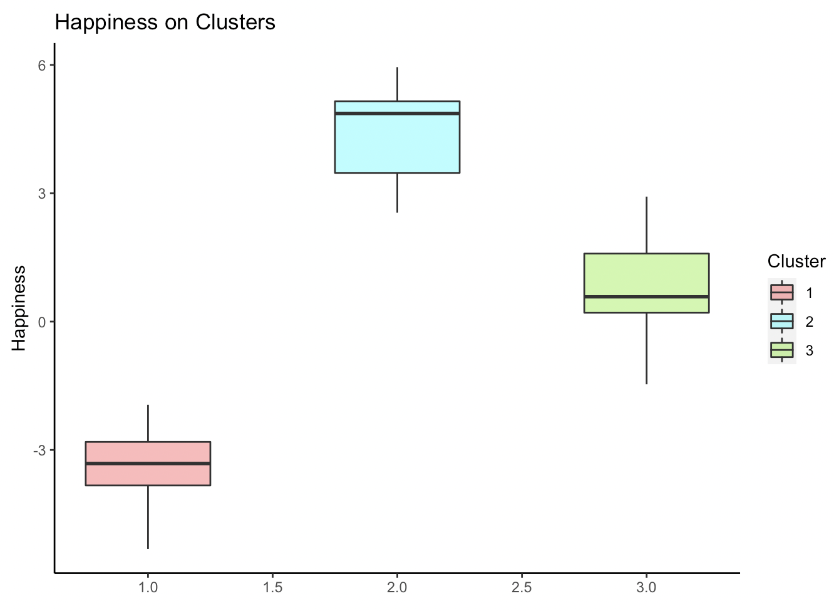
Brief Summary
Methods
EDA
Machine Learning
Cluster
Improvement
Cluster Analysis

Slide 10
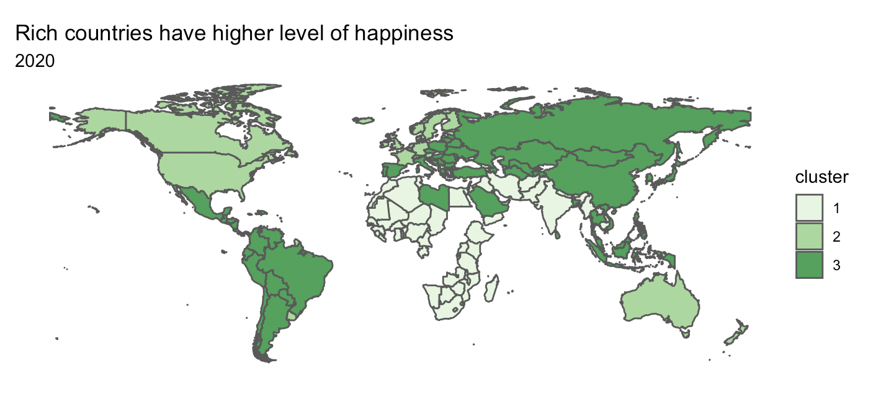
Brief Summary
Methods
EDA
Machine Learning
Cluster
Improvement
Cluster Analysis

Slide 11
Brief Summary
Methods
EDA
Machine Learning
Cluster
Improvement
Improvement
Rour indices related to COVID-19 are simple averages of the individual component indicators
Indicators here are ordinary

Slide 12
THANKS

